Slide 1
BBA SEM V-ESB UNIT - II

Slide 2
The size of a business unit can vary significantly depending on the organization and industry. Business units can range from small, specialized teams within a larger corporation to substantial divisions with hundreds or even thousands of employees. Factors influencing size include the scope of operations, market reach, revenue contribution, and strategic importance within the overall structure of the parent company

Slide 3
business unit
Medium Sized Business Unit
Small Business Unit
Large Business Unit

Slide 4
SMALL BUSINESS UNIT
Team Size: Typically have a smaller team of employees focused on specific tasks or projects.
Scope: Focus on niche markets, products, or services with limited geographical reach.
Flexibility: More agile and adaptable to market changes and customer needs.
Operational Efficiency: Can operate with lower overhead costs and more streamlined processes.
Examples include small retail stores, home-based businesses, and small-scale manufacturing units.

Slide 5
MEDIUM SIZED BUSINESS UNIT
Team Size: Moderate-sized teams with specialized roles and functions.
Market Reach: Serve broader markets or regions within a country.
Resource Allocation: Have sufficient resources and budgets to support growth and expansion initiatives.
Management Complexity: Moderate levels of hierarchy and management layers.
Examples include regional distributors, medium-sized factories, and service providers.

Slide 6
Factors Influencing the Size of a Business
Capital Availability: The size of the business depends on the funds available for initial setup and operations.
Market Demand: High market demand may justify a larger business size, while niche markets may be better served by smaller units.
Nature of Business: Industries like technology or consultancy may thrive as small units, while manufacturing often requires larger setups.
Goals and Vision: The entrepreneur's long-term objectives influence whether the business should remain small or scale up.
Legal and Regulatory Constraints: Certain industries or locations have restrictions on business size and operations.
Risk Appetite: Larger businesses often entail greater risk, while smaller units offer more flexibility and lower stakes.

Slide 7
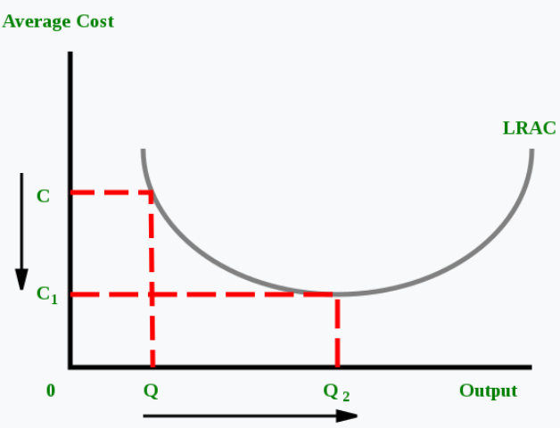
OPTIMUM FIRM

Slide 8
THE CONCEPT OF OPTIMUM FIRM IN ECONOMICS

Slide 9
CONCEPT OF OPTIMUM FIRM
It is important to understand the concept of optimum firm. The optimum firm refers to the best or ideal size of the firm. More specifically optimum or best firm is considered as one that has set up a plant with lowest possible cost and is also operating it at its lowest average cost point. E.A.G. Robinson who has done a good deal of research on the issue of optimum firm writes, “an optimum firm is the one which operates at the scale at which, in the existing conditions of technique and organising ability, has the lowest average cost of production when all those costs which must be covered in the long run are included”.
This means that optimum firm is one which operates at the lowest point of long-run average cost curve of production. Production at the minimum point of the long-run average cost curve is called optimum because at it resources of the society are most efficiently used.

Slide 10
CONCEPT OF OPTIMUM FIRM
When a firm expands its size to the lowest point of the long-run average cost (LAC), it sets up a plant which, given the state of technology, has the lowest unit cost of production when operated at its full capacity. As has been explained above that long-run average cost of a firm is influenced by the various economies and diseconomies of scale. These economies and diseconomies are determined by various technical, managerial, financial and marketing factors.
The optimum size is achieved when all the internal economies of scale such as division of labour, use of specialised machinery, manage­rial advantage of large scale production etc. are being fully enjoyed by the firm and the internal diseconomies of scale have not yet started accruing to it.

Slide 11
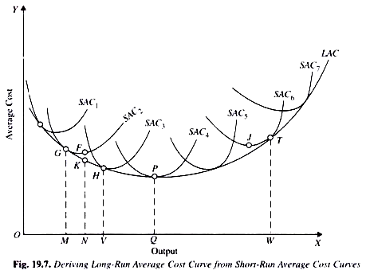
It is worth noting that in the determination of optimum size, the state of technology and methods of organising business remain unchanged. In Fig. 19.7 optimum firm is one that has set up a plant represented by short-run average cost curve SAC₄ and operating at the minimum point P on it and producing output OQ.
It is clear from Fig. 19.7 that in the continuous long-run average cost curve both for outputs less than OQ and more than OQ no plant is used at its point of minimum average cost. It is only the plant, the minimum point of whose short-run average cost curve coincides with the minimum point of the long-run average cost curve, which is operated at the point of minimum point of its short-run average cost curve. In Fig. 19.7 for producing output OQ, the plant of SAC₄ is being utilized to produce its optimum output OQ, that is to say, it is being used at its full capacity.
It should be noted that in Fig. 19.7 the plant of SAC₄ is optimum plant, since its minimum cost of production is the lowest of the minimum costs of all other plants. If the size of the plant is increased beyond SAC₄, it results in higher average cost of production.
Similarly, if the size of the plant is smaller than SAC₄, average cost of production is higher. Further, the least-cost output, or in other words, the optimum output of the plant SAC₄ is OQ. Now, if the firm produces output OQ with the optimum plant SAC₄, it is said to have achieved the optimum size.

Slide 12
LARC – Low Run Average Cost Curve
SAC/SRAC – Short Run Average Cost
M → The Initial Point Of The Downward Slope, Marking The Start Of Economies Of Scale.
N → The Lowest Point Of The Curve, Indicating The Firm's Most Cost-efficient Level Of Production (Optimal Scale).
V → The Upward Slope Begins, Signaling The Start Of Diseconomies Of Scale.
W → A Point Further Along The Upward Slope Where Inefficiencies Significantly Impact Costs.

Slide 13
LARC Curve (Long-Run Average Cost Curve): Definition and Explanation
The LARC curve, or Long-Run Average Cost Curve, represents the relationship between the average cost per unit of output and the level of production when all inputs are variable. It is derived by combining the lowest points of a series of short-run average cost (SRAC) curves, each corresponding to a different plant size or scale of operation.
The LARC curve is U-shaped, reflecting economies and diseconomies of scale:
Economies of Scale (Downward Slope): As production increases, the average cost per unit decreases due to better utilization of resources, bulk purchasing, specialization, and other factors.
Constant Returns to Scale (Flat Section): The average cost remains constant as the firm produces at its most efficient scale.
Diseconomies of Scale (Upward Slope): Beyond a certain production level, average costs increase due to inefficiencies such as overmanagement, resource constraints, or logistical complexities.

Slide 14
Key Features of the LARC Curve:
Represents Long-Term Decisions: Shows costs when a firm can fully adjust all inputs (labor, capital, etc.).
Derived from SRAC Curves: The LARC curve is the envelope of multiple SRAC curves, representing various production scales.
Indicates Optimal Scale: The minimum point of the LARC curve represents the firm's most efficient scale of operation (optimum firm size).
Dynamic Nature: The curve shifts with technological advancements or changes in input costs.

Slide 15
Importance of the LARC Curve:
Optimal Production Planning: Helps firms identify the most cost-efficient level of output.
Long-Term Decision-Making: Guides decisions on plant size, capacity expansion, and market entry.
Cost Management: Assists in controlling costs by avoiding inefficiencies.
Strategic Analysis: Useful in assessing competition and market structure.

Slide 16
OPTIMUM FIRM
An "optimum firm" refers to a company operating at the ideal size, where it produces at the lowest possible average cost per unit, considering its current technology, managerial capabilities, and organizational structure, essentially meaning it is producing at the most efficient scale with the least waste and maximum output for the given conditions; this point is typically identified as the lowest point on a firm's long-run average cost (LRAC) curve in economic theory.
It is important to explain the concept of optimum firm. The optimum firm refers to the best or ideal size of the firm. More specifically optimum or best firm is considered as one that has set up a plant with lowest possible cost and is also operating it at its lowest average cost point.

Slide 17
OPTIMUM FIRM
Key points about an optimum firm
1. Lowest average cost:
The defining characteristic of an optimum firm is that it produces at the point where its average cost per unit is the lowest, maximizing efficiency and minimizing waste.
2. Long-run perspective:
The concept of an optimum firm is considered in the long run, where a company can adjust its plant size and production capacity to achieve the most efficient scale.
3. LRAC curve analysis:
To determine the optimum firm size, economists analyze the firm's long-run average cost curve, which shows the average cost of production at different output levels. The point where the curve is at its lowest represents the optimum firm size.
4. Economies of scale:
When a firm increases its production scale and experiences decreasing average costs, it is benefiting from economies of scale, which can contribute to reaching the optimum size.
5. Diseconomies of scale:
Conversely, if a firm grows too large, it may encounter diseconomies of scale, where average costs start to rise due to factors like increased management complexity or coordination issues, indicating that the firm has surpassed its optimum size.

Slide 18
OPTIMUM FIRM
Factors affecting optimum firm size:
Technology:
Technological advancements can significantly impact the optimal firm size, allowing for larger production runs with lower average costs.
Industry characteristics:
Different industries have different optimal firm sizes based on factors like capital requirements, market size, and competition.
Management capabilities:
A firm's ability to effectively manage a larger workforce and operations will influence its optimum size.
Example:
Imagine a car manufacturing company that can produce 100 cars at a certain average cost, but by increasing production to 1000 cars, it can utilize economies of scale to significantly lower its average cost per car. This higher production level would represent the "optimum firm size" for this company, assuming no other factors limit its growth.

Slide 19
The ECONOMIC SIZE
What are Economies of Scale?
Economies of scale refer to the cost advantage experienced by a firm when it increases its level of output. The advantage arises due to the inverse relationship between per-unit fixed cost and the quantity produced. The greater the quantity of output produced, the lower the per-unit fixed cost.
Economies of scale also result in a fall in average variable costs (average non-fixed costs) with an increase in output. This is brought about by operational efficiencies and synergies as a result of an increase in the scale of production.

Slide 20
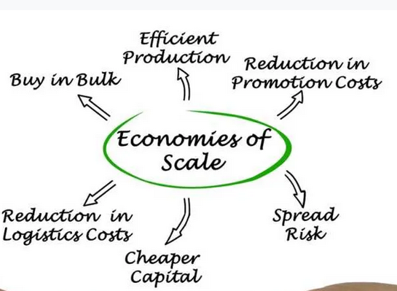
The ECONOMIC SIZE

Slide 21
Effects of Economies of Scale on Production Costs
It reduces the per-unit fixed cost. As a result of increased production, the fixed cost gets spread over more output than before.
It reduces per-unit variable costs. This occurs as the expanded scale of production increases the efficiency of the production process.

Slide 22
REPRESENTATIVE FIRM
A representative firm is a hypothetical business used in economic models to represent the behavior and performance of an average firm in a particular industry or market.
A representative firm is a theoretical construct in economic analysis that represents the typical or average firm in a particular industry or market. It is used to simplify the complexities of real-world markets by assuming that the behavior and characteristics of this hypothetical firm reflect those of all firms in the industry
This approach allows economists to analyze industry trends, predict market outcomes, and assess the effects of economic policies without considering the specific details of individual firms.
For example, when analyzing the impact of a new tax policy on the automotive industry, economists might use a representative firm to model how the average car manufacturer would be affected, rather than examining each company individually.

Slide 23
REPRESENTATIVE FIRM
THUS,
A representative firm is a conceptual tool used in economics to simplify the analysis of industry behavior and market outcomes.
It assumes that the firm’s actions and performance are indicative of the average firm within the industry.
This concept helps economists study market dynamics, efficiency, and the impact of policy changes on a typical firm.

Slide 24
PURPOSE OF USING A REPRESENTATIVE FIRM
The primary purpose of using a representative firm in economic analysis is to create a simplified and manageable model that captures the essential features of an industry.
This approach offers several advantages:
Simplification: It reduces the complexity of analyzing numerous firms with different behaviors and characteristics by focusing on a single, average entity.
Generalization: It provides insights that can be generalized to the entire industry, helping policymakers and researchers understand broader market trends.
Efficiency: It enables more efficient analysis and modeling, making it easier to study the effects of economic policies, technological changes, and other factors on the industry as a whole.
By focusing on a representative firm, economists can derive meaningful conclusions about market behavior and policy impacts without being bogged down by the details of individual firms.

Slide 25
PURPOSE OF USING A REPRESENTATIVE FIRM
The primary purpose of using a representative firm in economic analysis is to create a simplified and manageable model that captures the essential features of an industry.
This approach offers several advantages:
Simplification: It reduces the complexity of analyzing numerous firms with different behaviors and characteristics by focusing on a single, average entity.
Generalization: It provides insights that can be generalized to the entire industry, helping policymakers and researchers understand broader market trends.
Efficiency: It enables more efficient analysis and modeling, making it easier to study the effects of economic policies, technological changes, and other factors on the industry as a whole.
By focusing on a representative firm, economists can derive meaningful conclusions about market behavior and policy impacts without being bogged down by the details of individual firms.

Slide 26
CHARACTERISTICS OF A REPRESENTATIVE FIRM
In constructing a representative firm, economists typically assume that it embodies certain average characteristics of the industry, such as:
Production Technology: The representative firm uses the average production technology and methods prevalent in the industry.
Cost Structure: It has an average cost structure, including fixed and variable costs, similar to other firms in the market.
Output Level: The firm’s output level is representative of the average production level in the industry.
Market Behavior: It behaves in a manner consistent with the typical competitive or market conditions faced by firms in the industry.
These characteristics help ensure that the representative firm accurately reflects the overall industry dynamics.

Slide 27
APPLICATIONS OF THE REPRESENTATIVE FIRM
CONCEPT
The concept of a representative firm is widely used in various areas of economic analysis, including:
Market Structure Analysis: Understanding how different market structures (e.g., perfect competition, monopoly) affect the behavior of firms and market outcomes.
Policy Impact Studies: Assessing the effects of government policies, such as taxation, subsidies, and regulation, on the average firm in an industry.
Economic Growth Models: Studying how technological advancements, capital accumulation, and other factors influence the productivity and growth of the average firm.
Industry Performance: Analyzing overall industry performance, efficiency, and profitability by examining the representative firm’s behavior.
These applications demonstrate the versatility and importance of the representative firm in economic research and policy analysis.

Slide 28
REPRESENTATIVE FIRM
THUS,
A representative firm is a conceptual tool used in economics to simplify the analysis of industry behavior and market outcomes.
It assumes that the firm’s actions and performance are indicative of the average firm within the industry.
This concept helps economists study market dynamics, efficiency, and the impact of policy changes on a typical firm.

